Slide 1
MECHATRONIC DESIGN
MIDSEMESTER PRESENTATION
TOM:
Trash Organizing Machine
TEAM B: JAIME CHU, SASCHA DEMETRIS, ANDREW KELLY, HANNAH LYNESS, NISHANT POL, PATRICIA XU
Notes:
Jaime

Slide 2
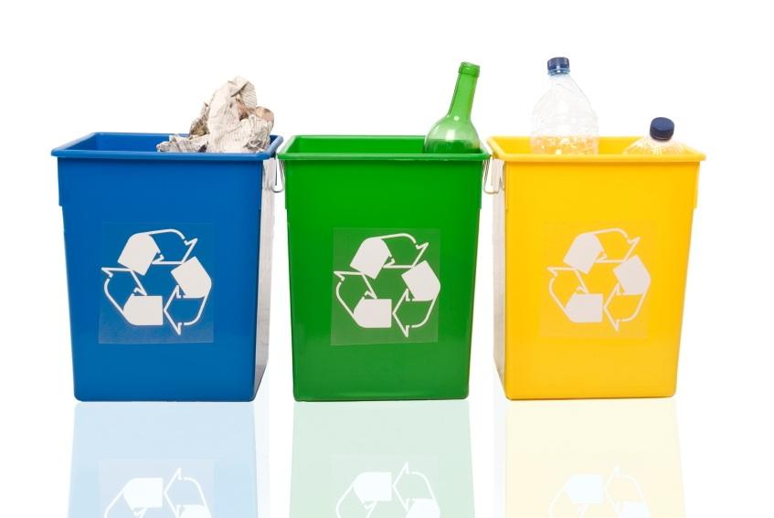
SELECTED DESIGN REQUIREMENTS
SYS-R5. Device shall classify trash input into four categories. metal, plastic, glass, and other. Accuracy of classification must be at least 85%.
SYS-R7. Device shall store trash input into two categories. (metal, plastic, glass) and other. Other category includes non-rigid plastic with no recycling number, cement, wood, ceramics, clothes, cotton, socks, wool, cardboard, newspaper, books, magazines, and styrofoam.
SYS-R8. Device shall accept trash at an average speed of 3 seconds per item for 15 items.
Notes:
Sascha

Slide 3
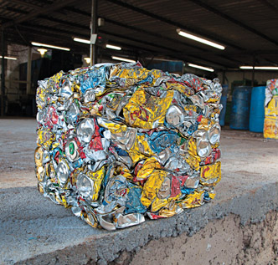
SELECTED DESIGN REQUIREMENTS (COOLNESS FACTORS)
SYS-R12. Device shall measure and report bin fullness.
SYS-R13. Device shall compress plastic and aluminum objects, but should not compress glass and “other” objects.
Notes:
Sascha

Slide 4
FUNCTIONAL ARCHITECTURE
Notes:
Jaime

Slide 5
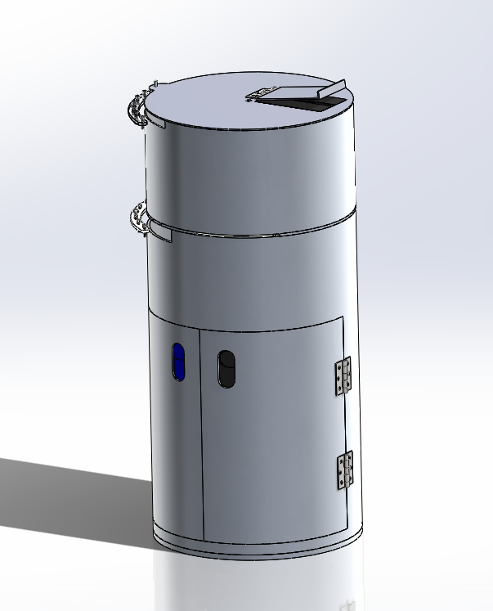
SYSTEM DESCRIPTION
Unit 1: Input and Sensing
Unit 2: Compacting
Unit 3: Sorting
Notes:
2 Andrew

Slide 6
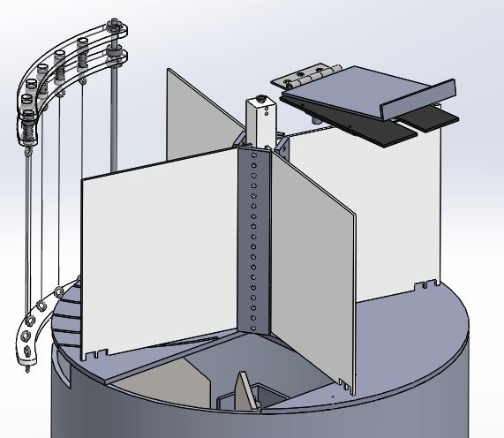
UNIT 1 DESIGN CONCEPT
Entry on top to fit with typical trash bin profile
Inductance sensors on entry flaps to come in close contact with metals
4 sensing chambers to allow for faster acceptance
Center paddles rotate to expose object to different chambers
Drop through to compacting
Notes:
Patricia

Slide 7
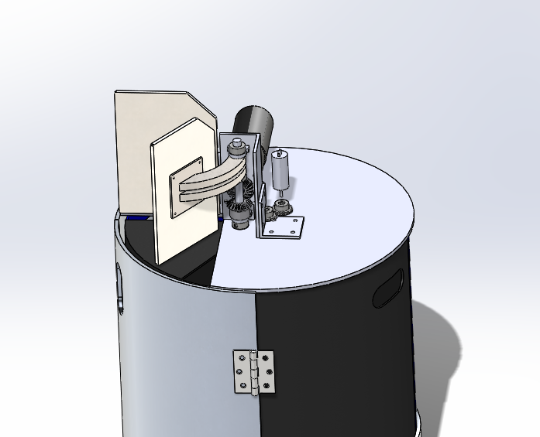
UNIT 2 DESIGN CONCEPT
Items fall through from Unit 1
Others directly to Trash
Glass directly to Recycling
Metals and Plastics fall onto the ‘Floor’
Metals and Plastics Compacted, then pushed into Recycling
Houses motors and electronics
Motor moves plate to compress item
{
Notes:
2 Andrew

Slide 8
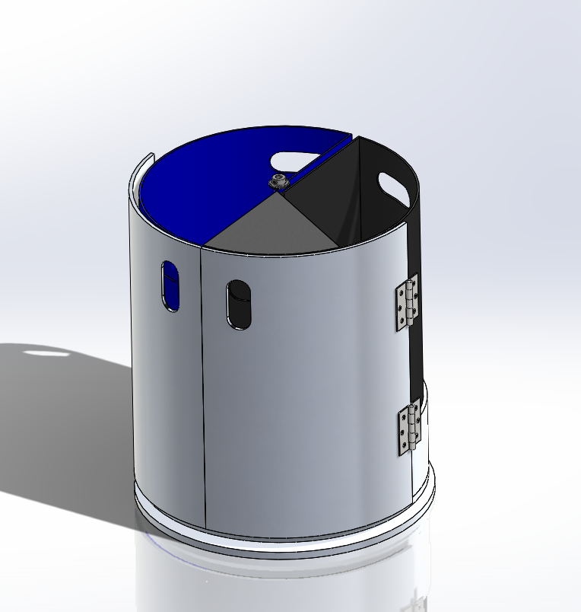
UNIT 3 DESIGN CONCEPT
Outer stationary frame
Inner platform holds separate bins, spins on lazy Susan turntable
Spins based on determination from Units 1 and 2
Large, easy-access doors to remove bins
Notes:
Andrew

Slide 9
CYBER-
PHYSICAL
ARCHI-
TECTURE
Notes:
Nishant

Slide 10
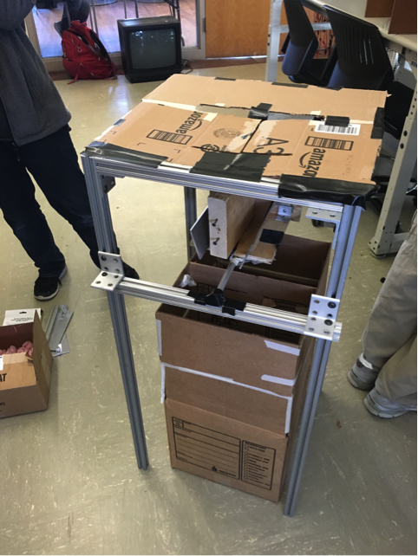
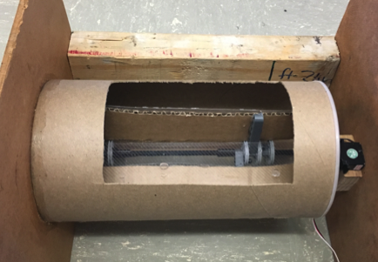
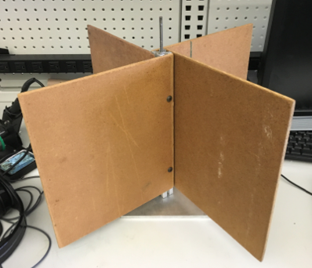
CURRENT SYSTEM STATUS - MECHANICAL
Entry Flaps
Entry Area
Frame prototype [1]: demonstrated challenges of attaching various elements to frame
Horizontal Revolving Door Prototype [2]: surfaced challenges with putting wires in a spinning cylinder
Vertical Spinning Entryway Prototype [3]: showed high torque required to spin trash
Three Divided Areas
Compacting Ram
Servomotor
2
Axis of Rotation
Four Vertical Chambers
1
Divided Bin
3
Notes:
Patricia

Slide 11
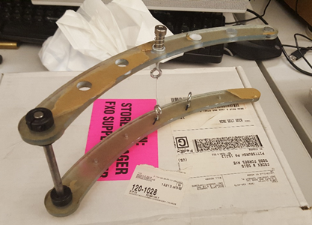
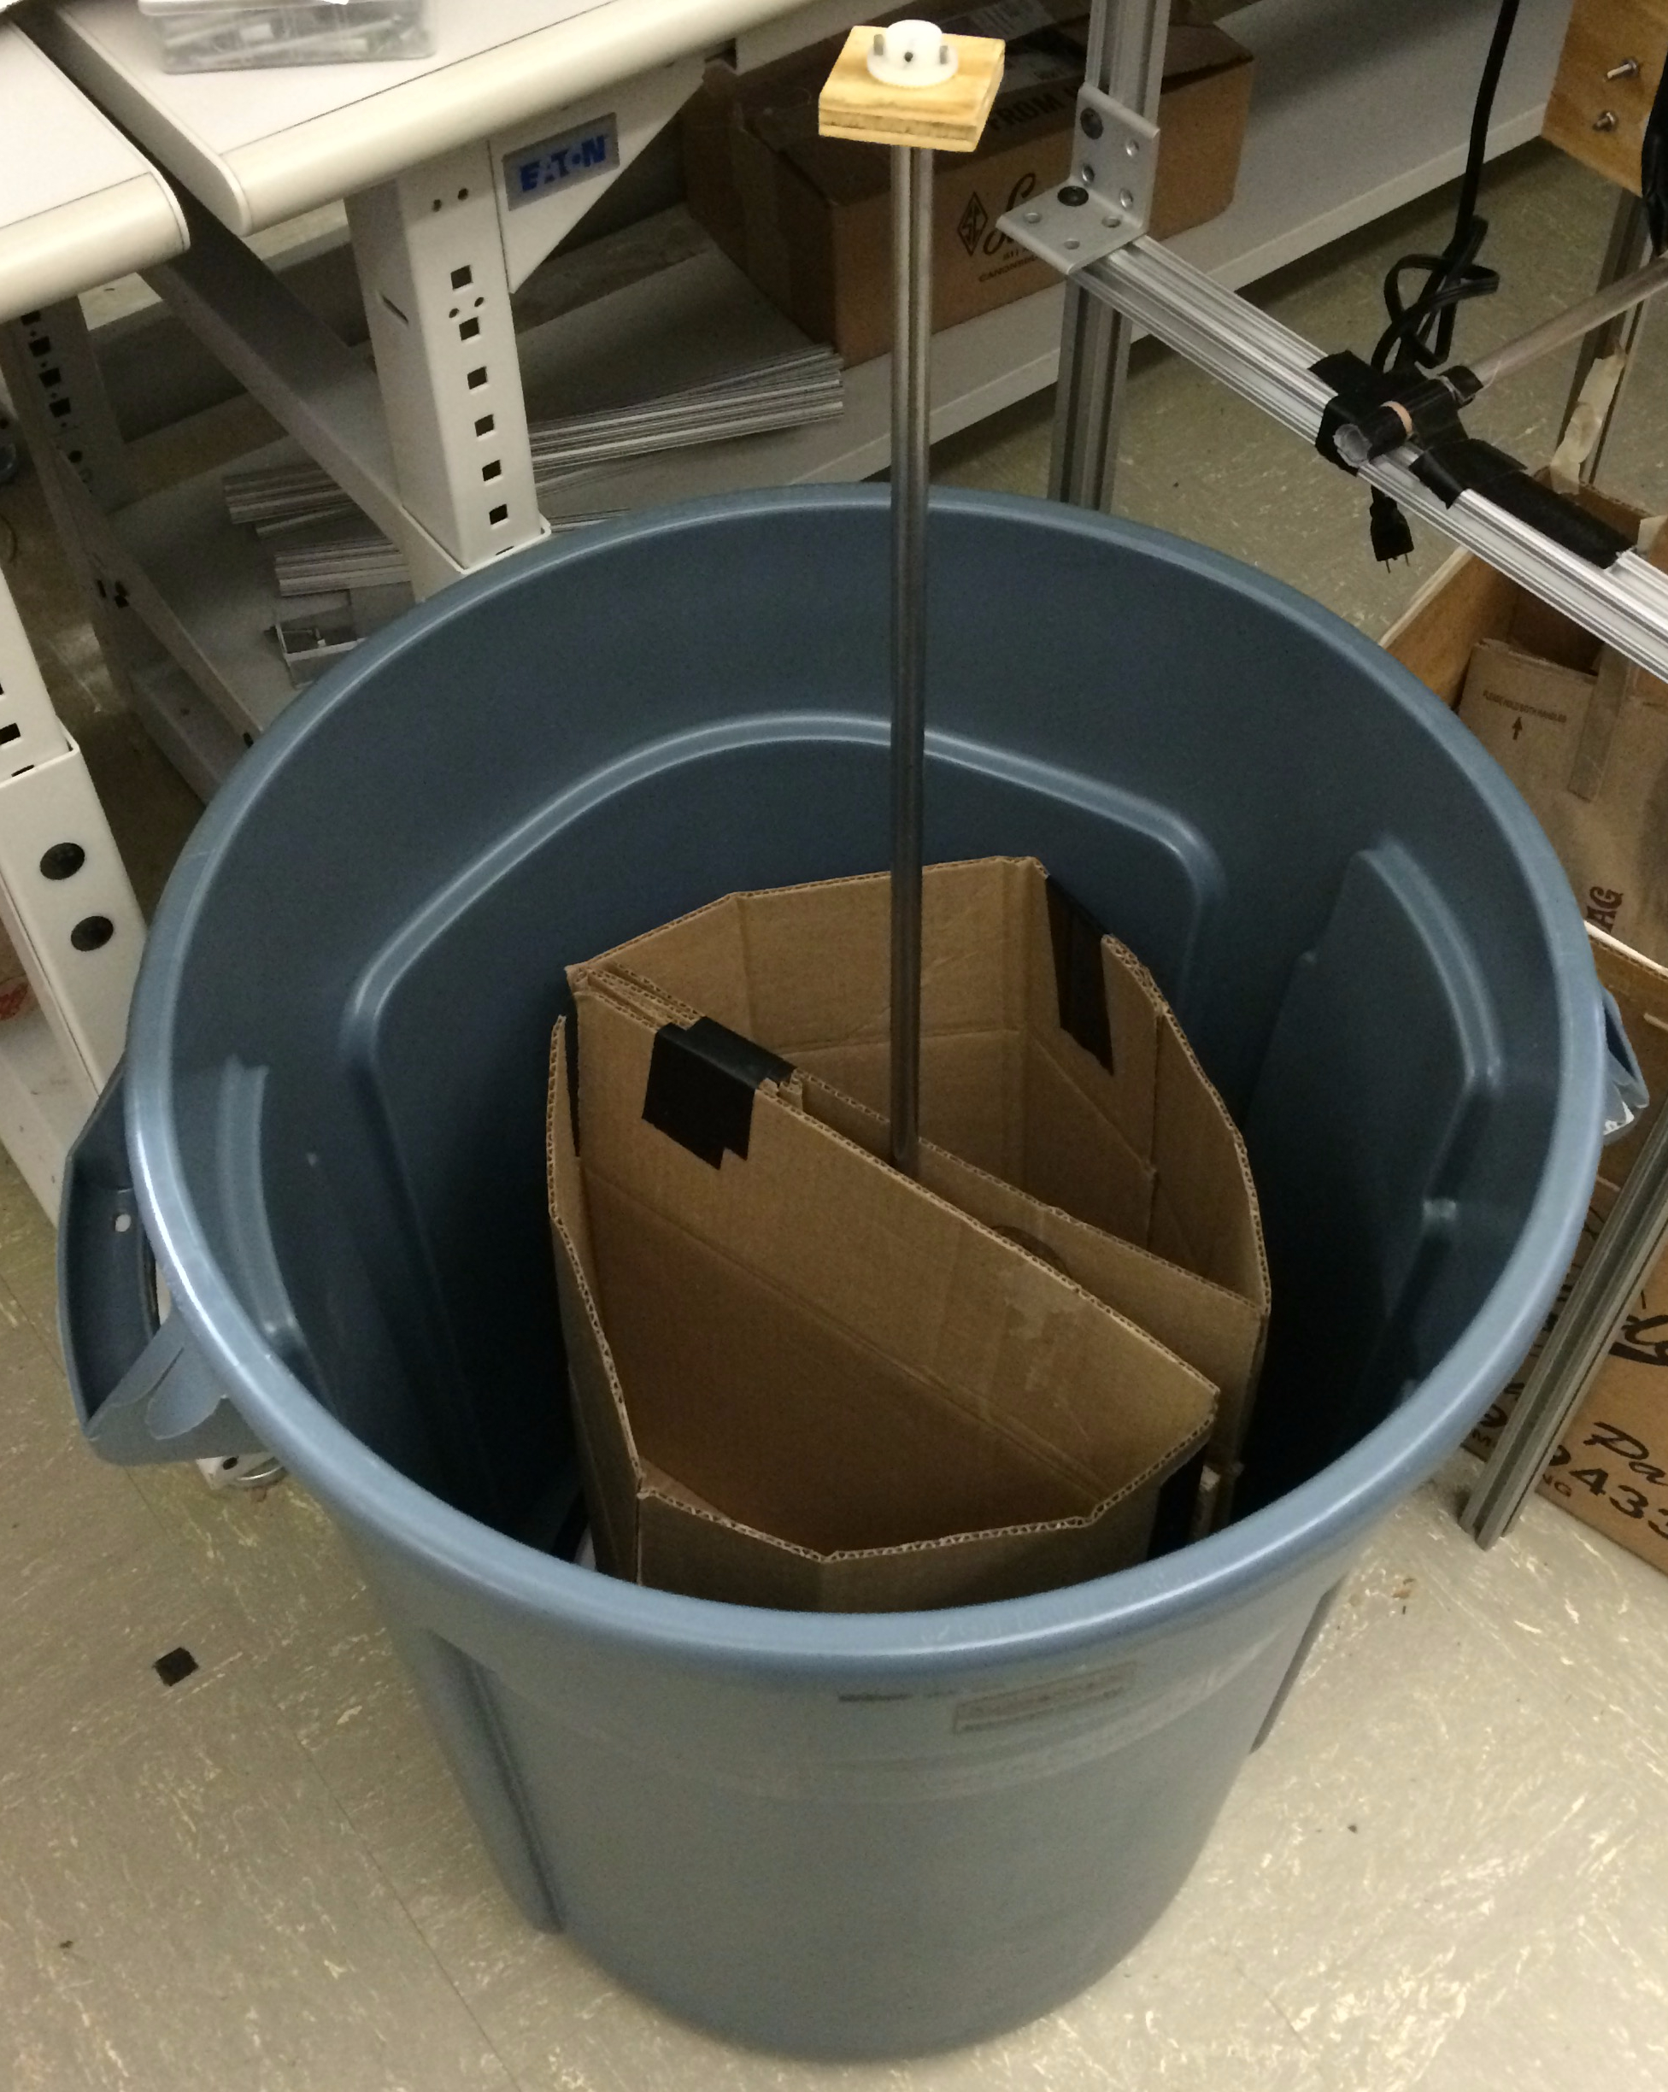
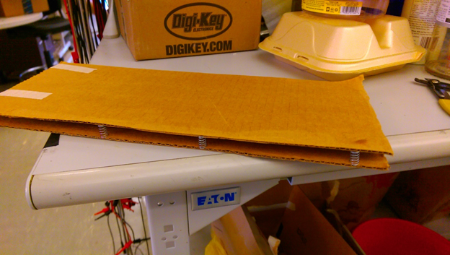
CURRENT SYSTEM STATUS - MECHANICAL (CONTINUED)
Hot wire harp[1]: need soft springs to ensure deflection and smooth high tolerance sliding bushings to allow vertical movement
Mass sensor[2]: surfaced challenges in placing the plates and springs in the chimney such that the paddles do not hit when spinning
Bin Prototype[3]: demonstrated feasibility of lazy susan, showed compilation of shaft attachment
Spring
Spinning shaft
Separate Bins
1
NiChrome Wire
Lazy Susan
3
Springs
2
Notes:
Sascha

Slide 12
CURRENT SYSTEM STATUS-ELECTRICAL
Inductance
(under flap)
Optical
Inductance (metals)
Measure eddy currents in target object
Mass: (glass, other)
Parallel plates separated by springs
Hall Effect sensor measures displacement, which is proportional to force
Optical: (transparent glass, plastic)
Near IR reflectivity
Hot wire: (Plastic, styrofoam)
Measure deflection of melting object
Probabilistic approach
Sensors assign probability
Each sensor has accuracy weighting
Hot Wire
Mass
Notes:
Nishant

Slide 13
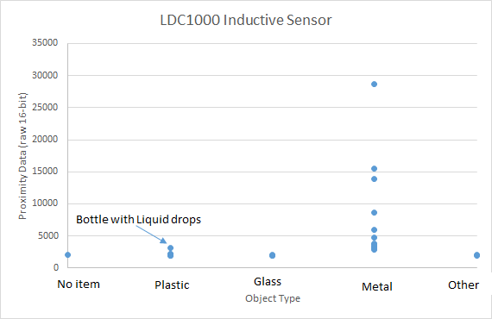
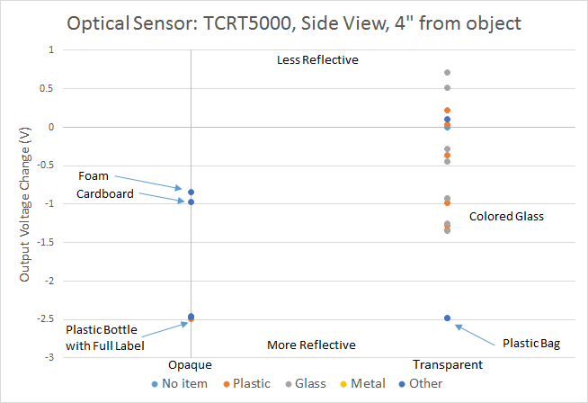
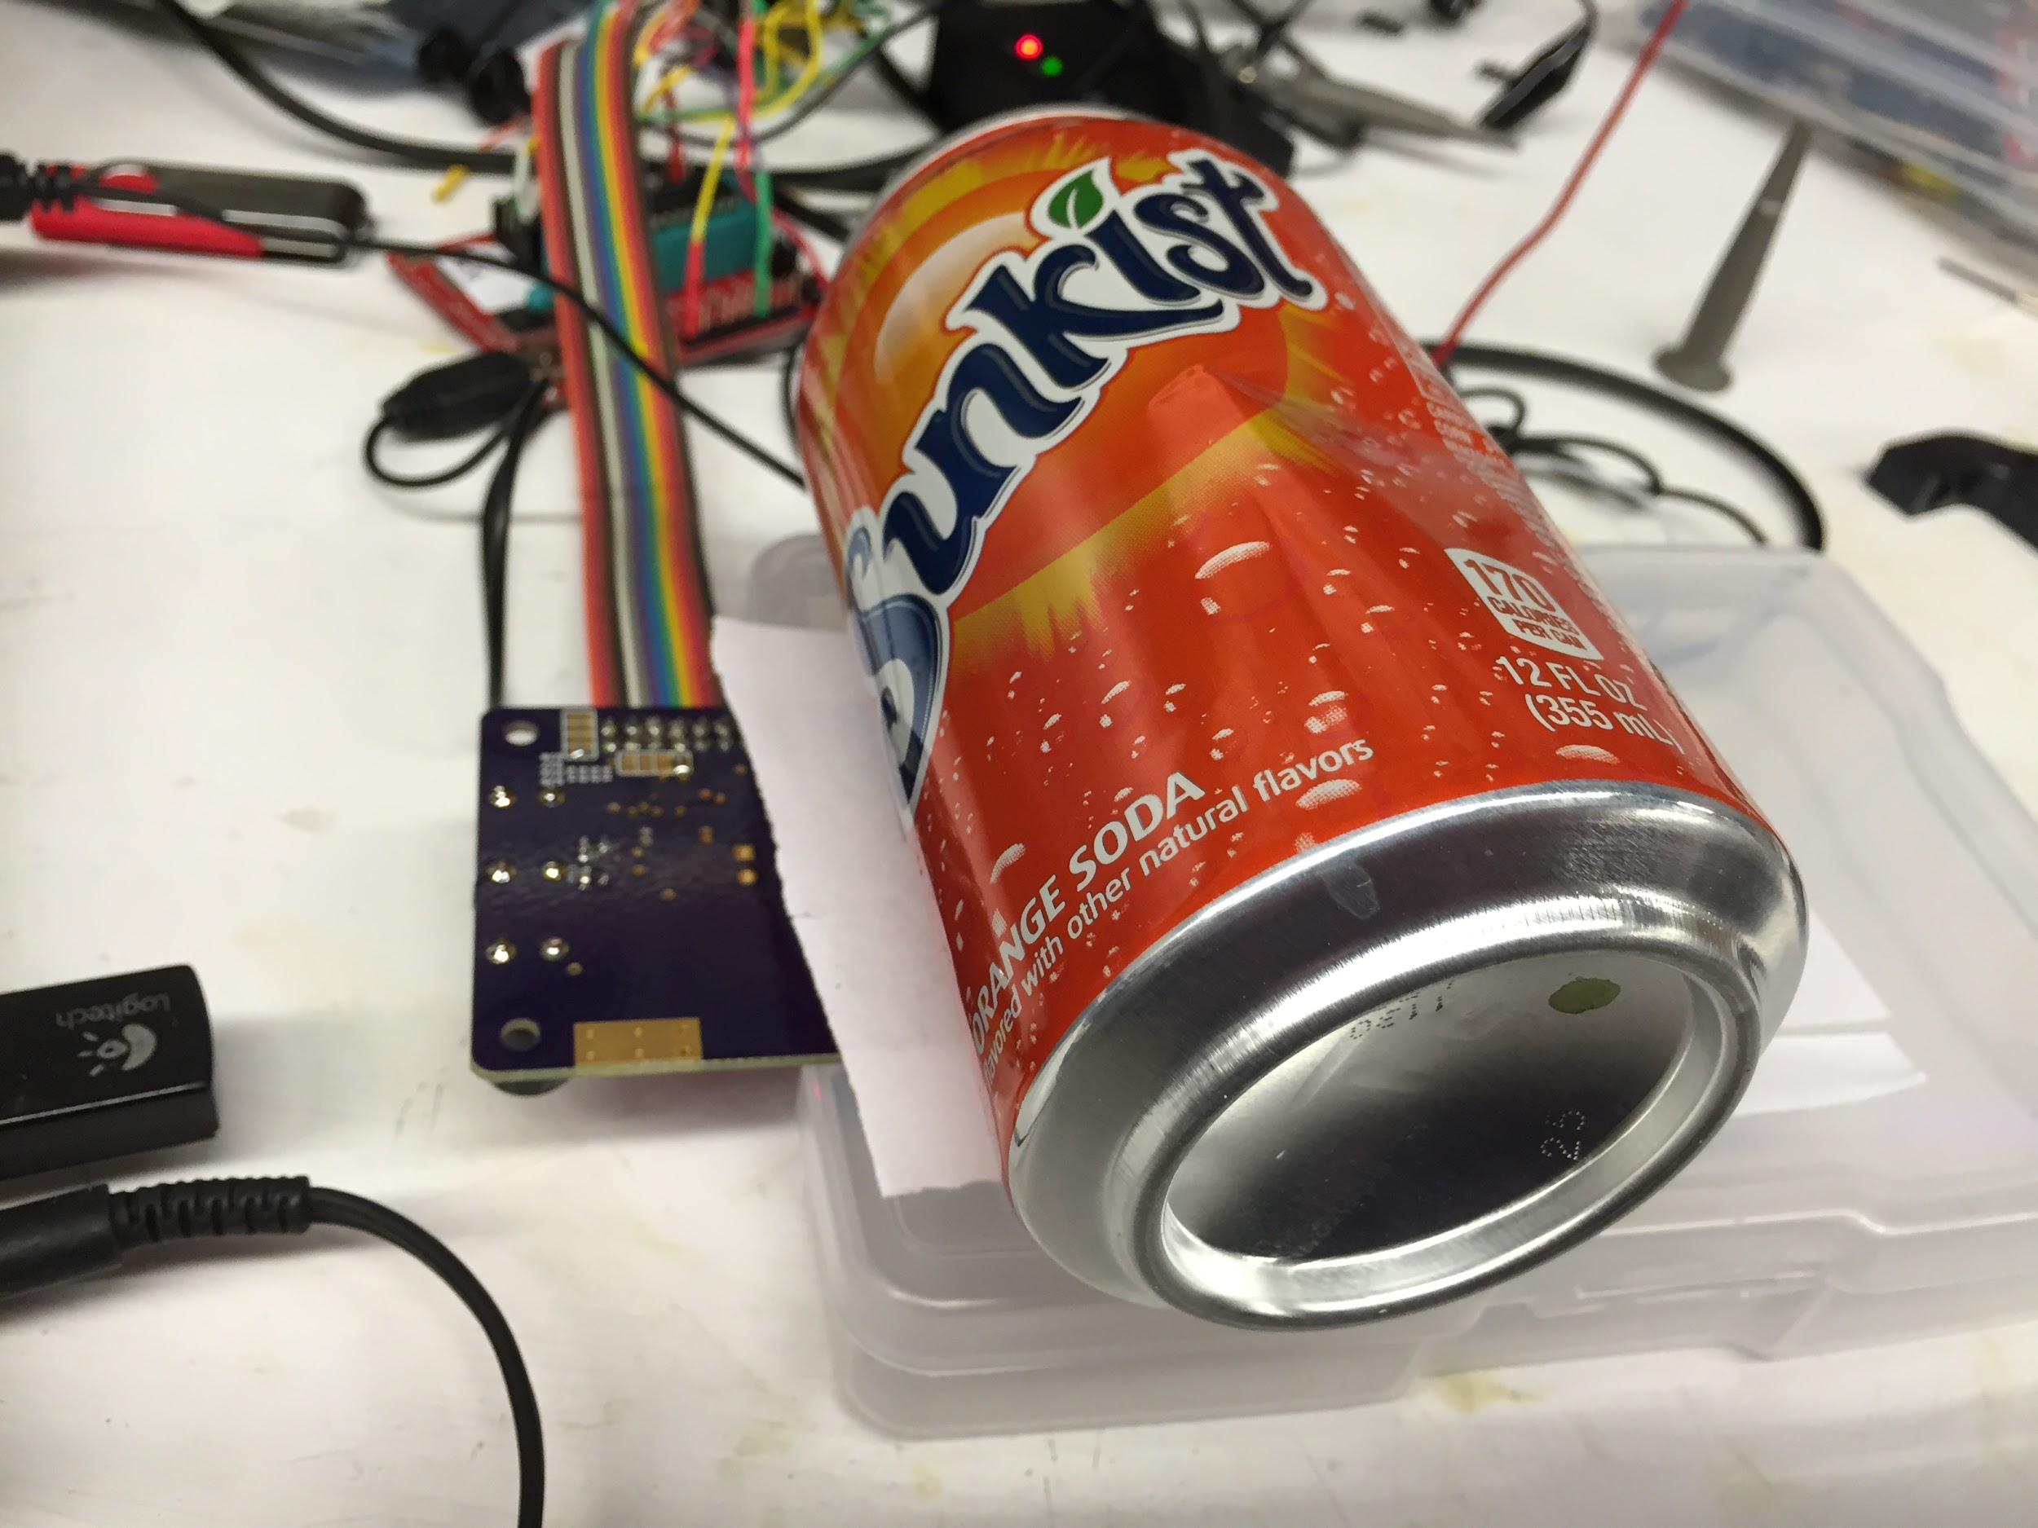
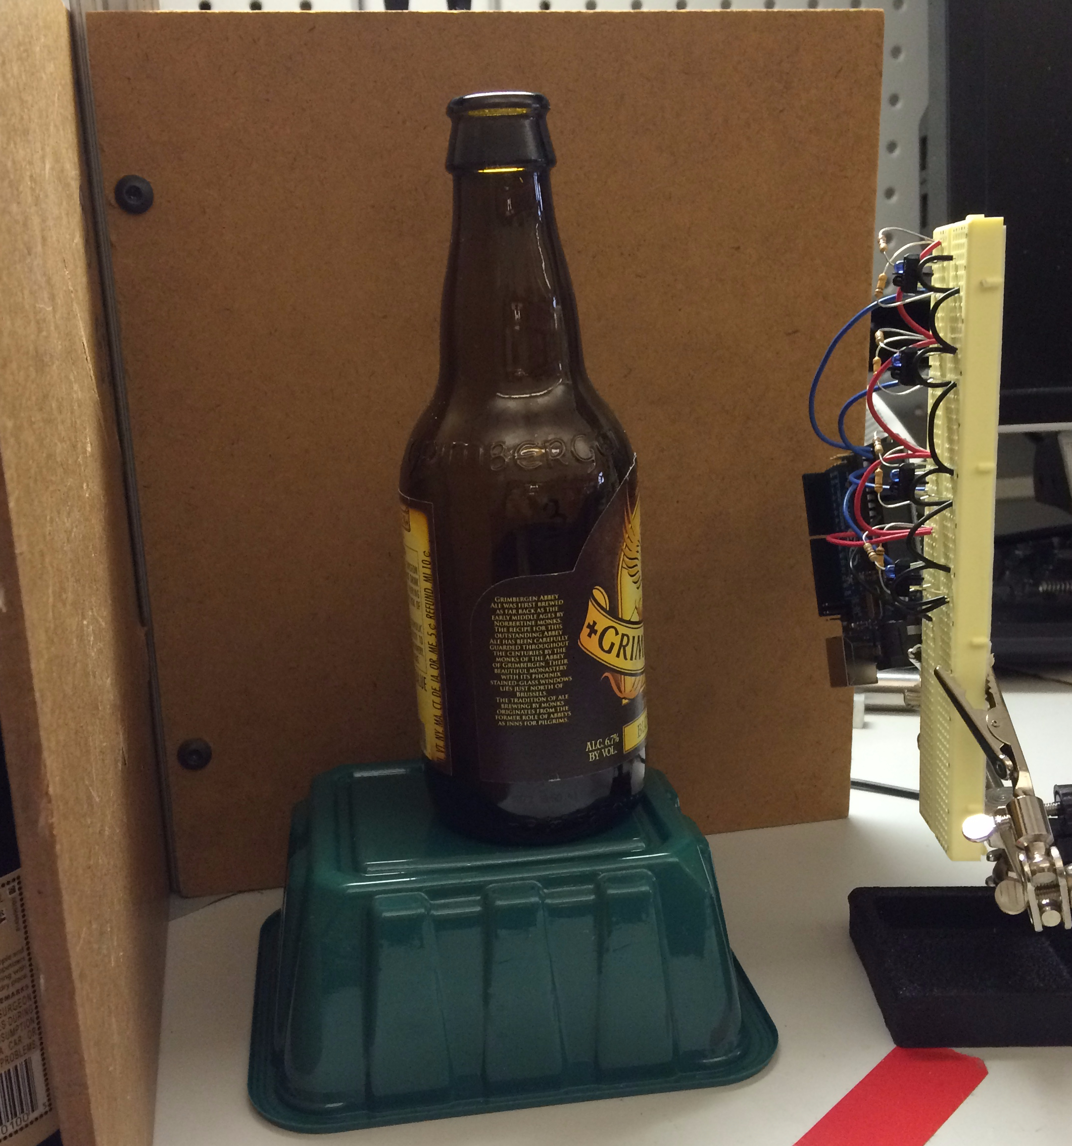
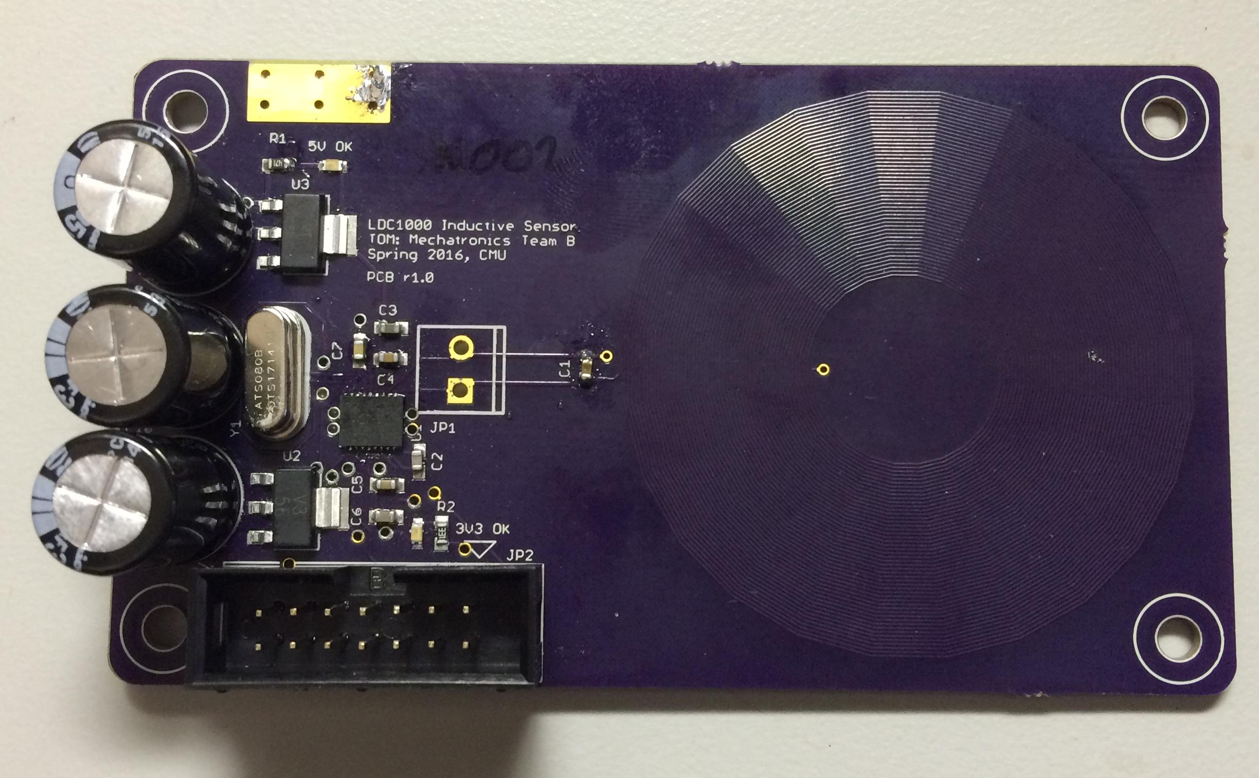
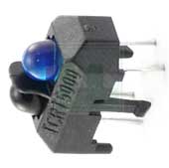
Sense Coil
optical sensors
Notes:
Jaime

Slide 14
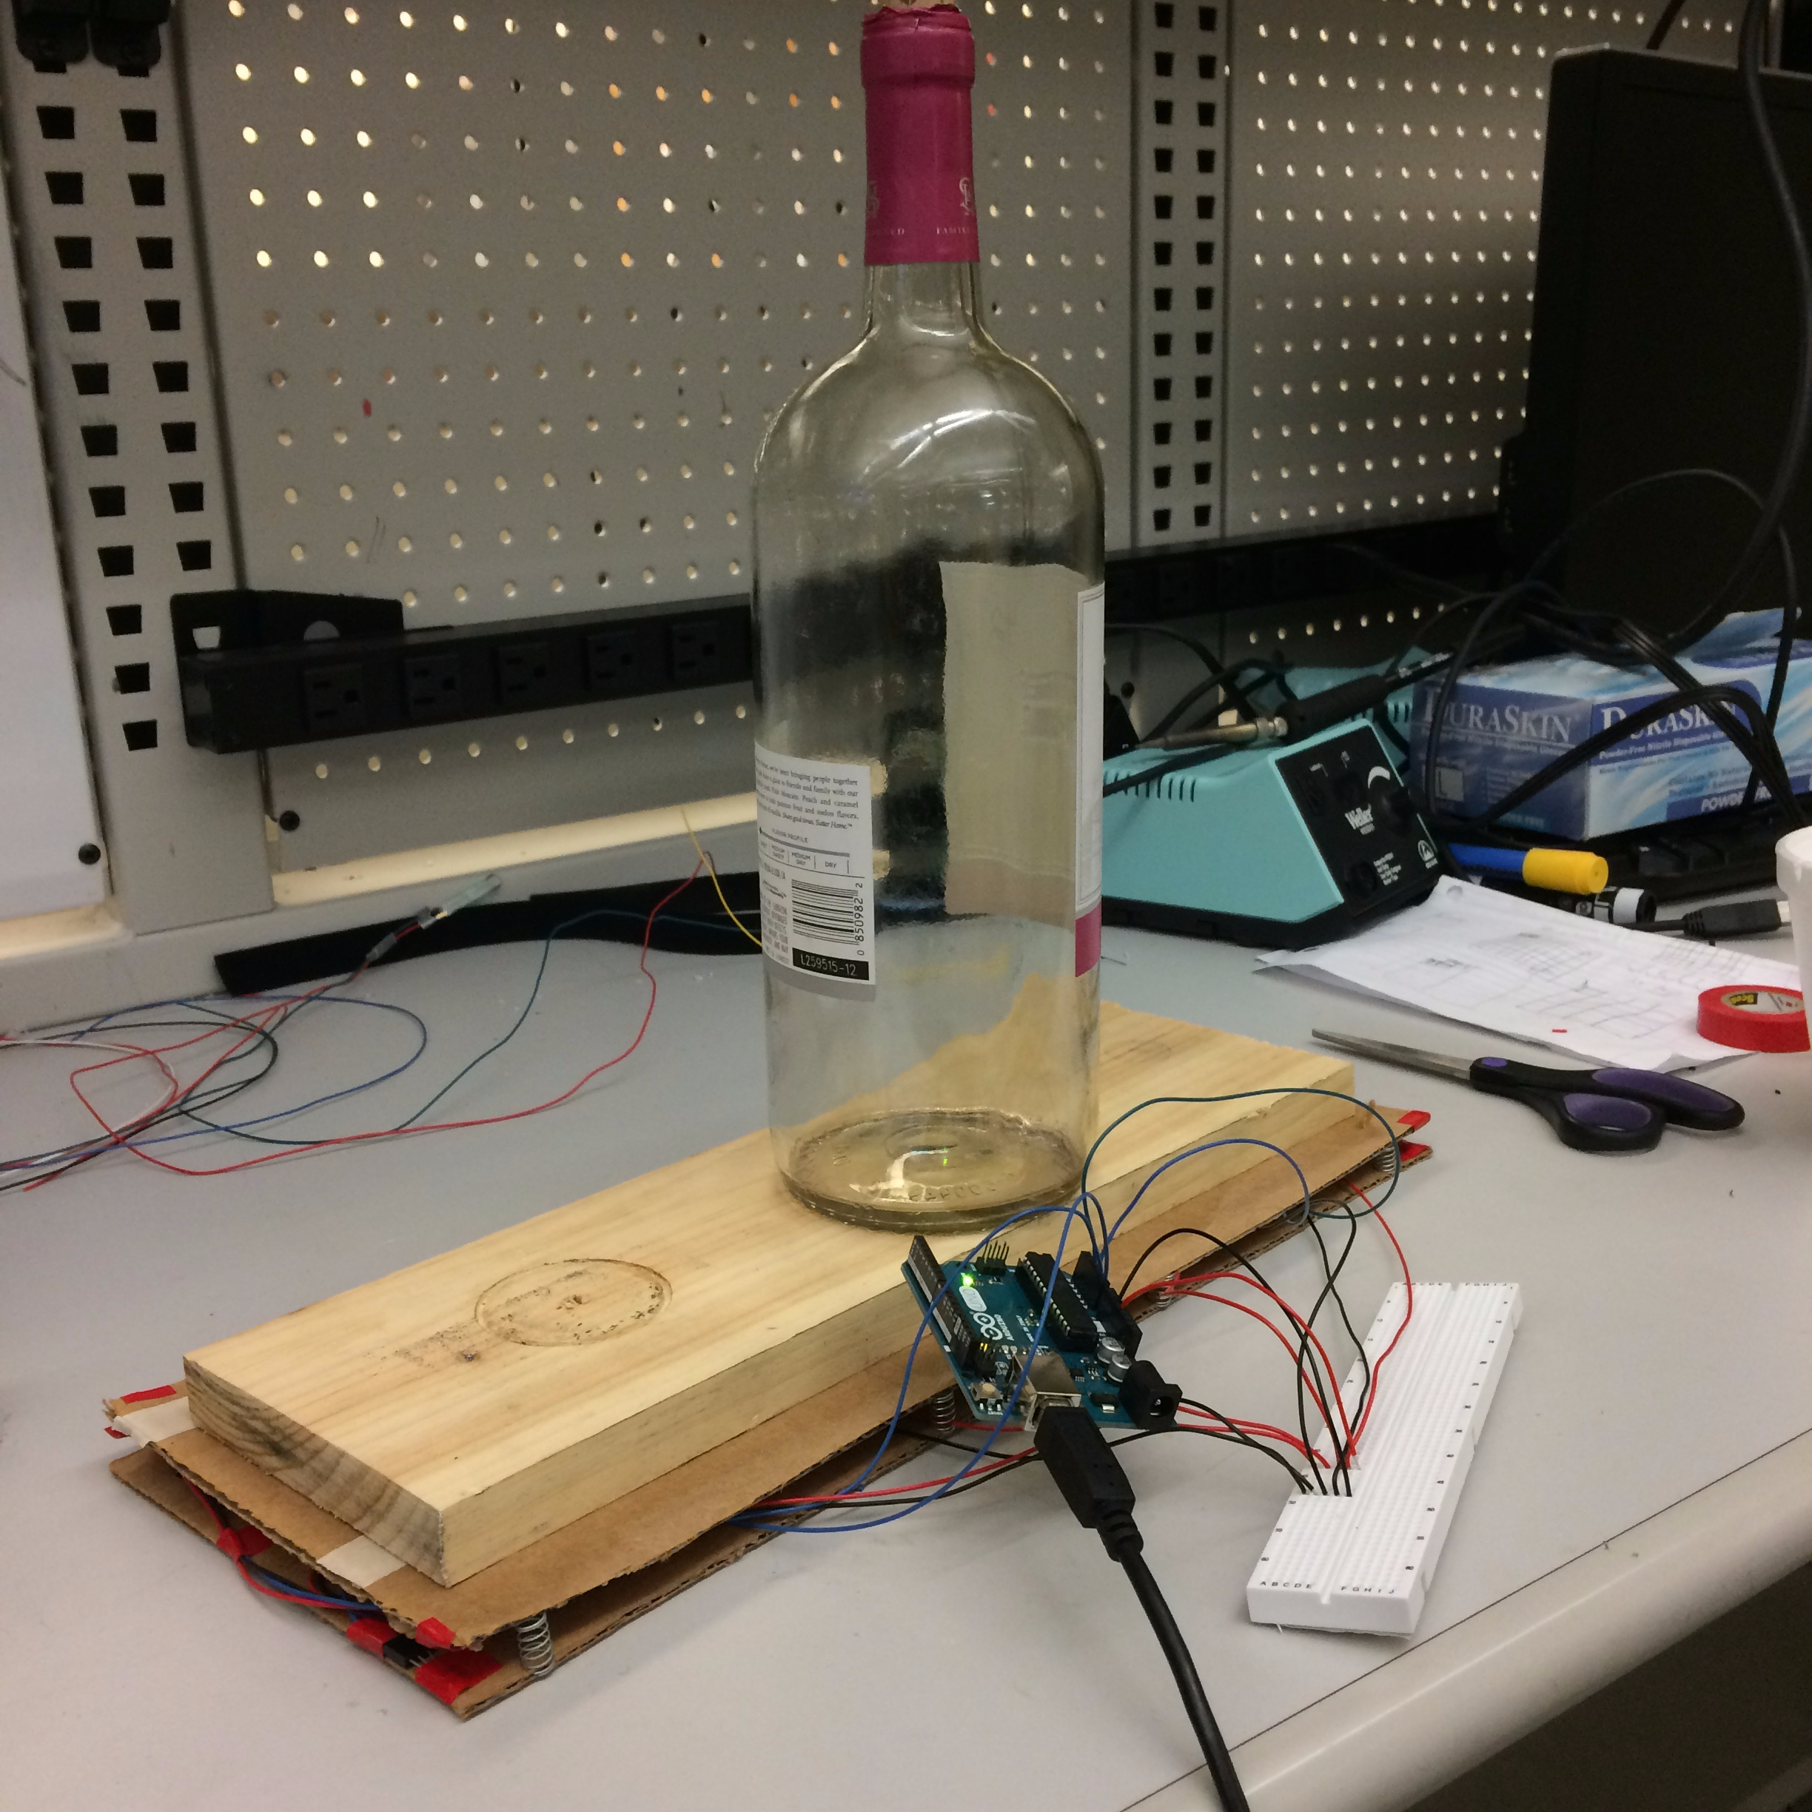
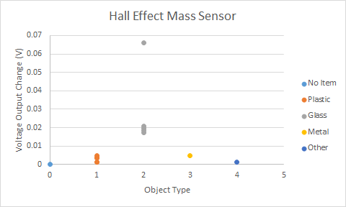
SENSING: MASS TESTING
parallel plates
and coil
Notes:
Jaime

Slide 15
PROJECT MANAGEMENT
Functional Teaming:
Sensing and Power
Nishant and Jaime
Unit 1 and Frame
Sascha and Patricia
Units 2 and 3
Andrew and Hannah
Risk Management
Customer Concerns - Hot Wire
Close to Budget
Frame Fabrication
FINANCES
Subsystem | To-Date | Expected
Electrical | $80 | $320
Mechanical (Unit 1) | $85 | $150
Mechanical (Unit 2) | $0 | $300
Mechanical (Unit 3) | $25 | $275
Total Cost | $190 | $1125
Notes:
Patricia

Slide 16
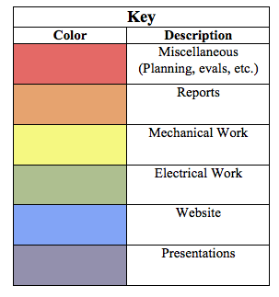
SCHEDULE
Divided by category
Project to finish early to allow time for debugging and improvement
Notes:
Hannah

Slide 17
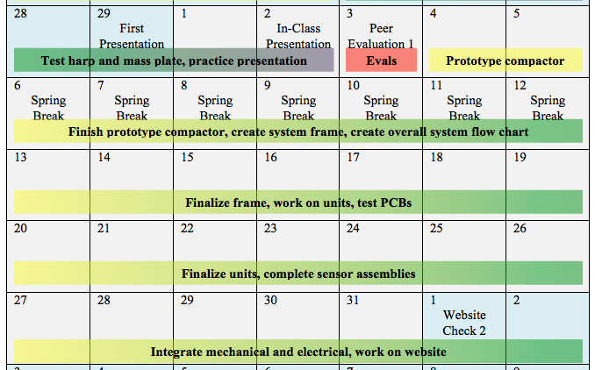
MARCH SCHEDULE
Notes:
Hannah

Slide 18
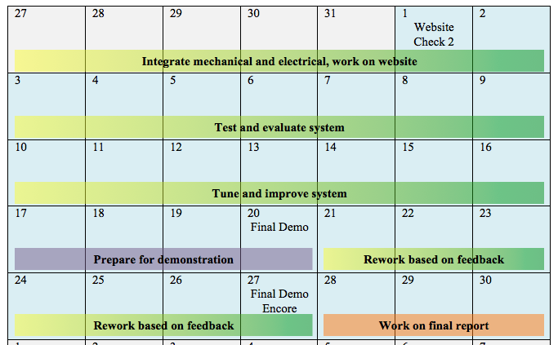
APRIL SCHEDULE
Notes:
Hannah

Slide 19
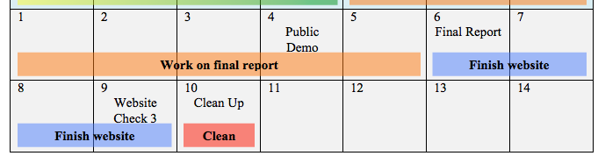
MAY SCHEDULE
Notes:
Hannah

Slide 20
THANK YOU

Slide 21
REFERENCES
https://www.cokecce.com/insights/recycle-for-the-future
http://www.americasquarterly.org/waste-and-recycling

